Slide 1
Climate Change & Catastrophic Events Working Party
XV – AIDA World Congress – Rio October 11-13 2018
“What’s happening in the World’s second driest continent?”

Slide 2
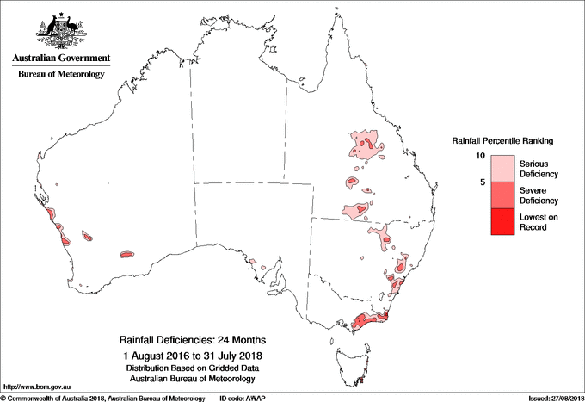
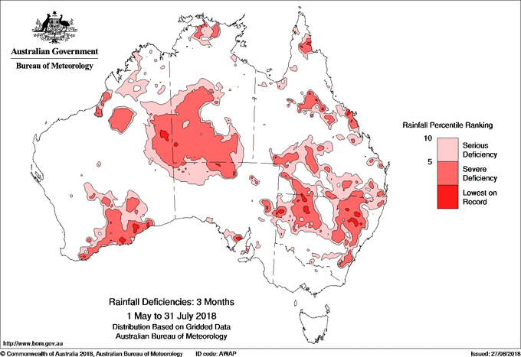
Australia – How bad is it ?

Slide 3
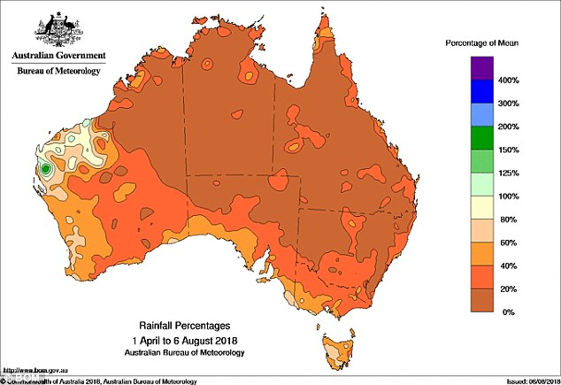
Rainfall data as a percentage of mean

Slide 4
The Extent of the drought on a dry continent
Nationally , the driest July since 2002
Driest Autumn since 1902
99% of NSW and 58% of Queensland affected – substantial part of Australia’s crop and livestock areas
Almost all of NSW has received less than 20% of usual rainfall since January
South and NE of South Australia and North and central Victoria – some of lowest rainfall on record
Heading into a likely El Nino summer with hotter and more extreme weather events

Slide 5
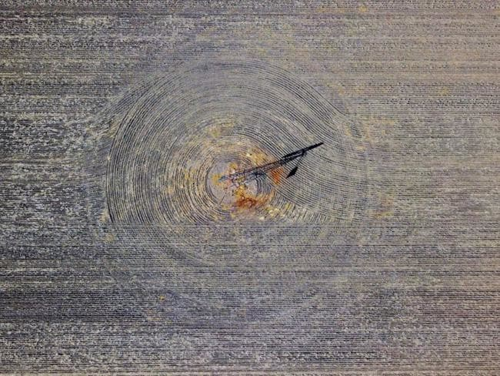
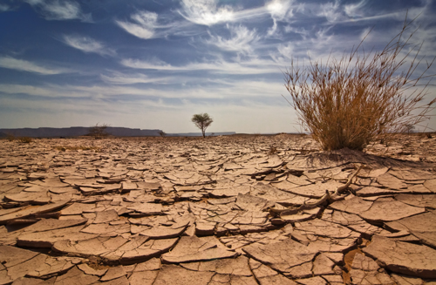
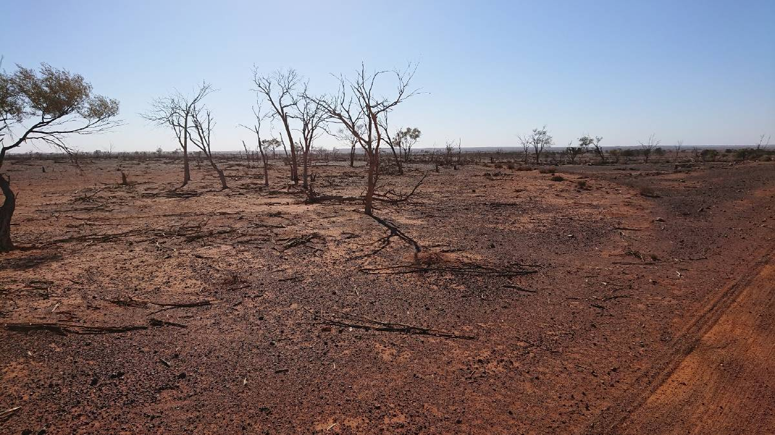
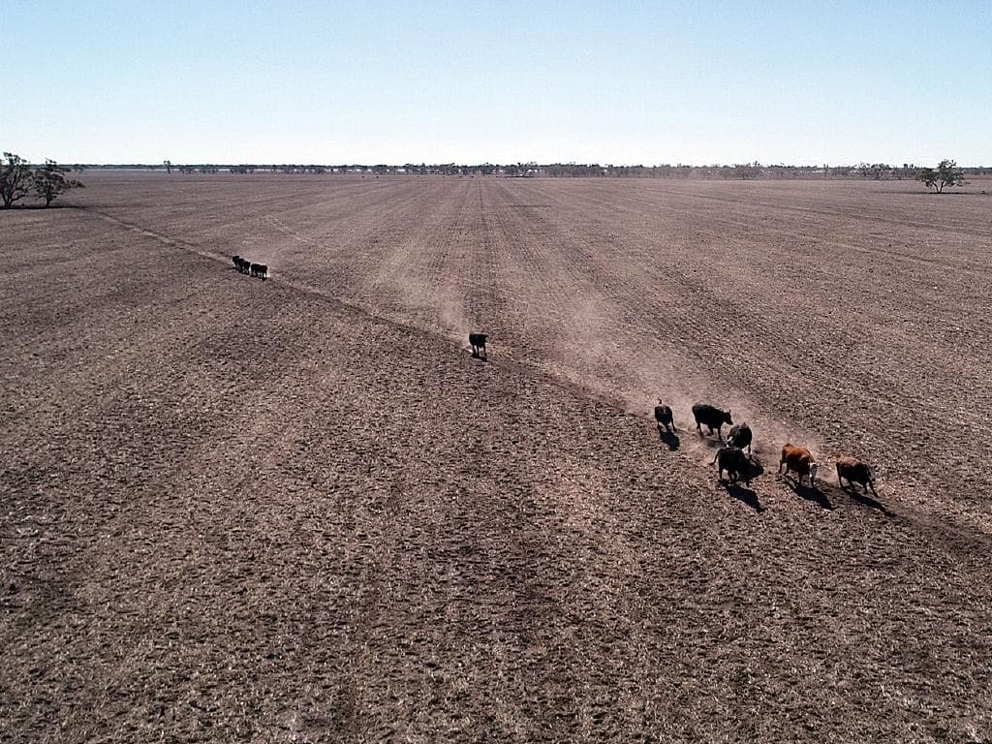

Slide 6
Australia and the “perfect storm”
One of the most severe and most prolonged droughts in Australian history.
Early and unseasonal onset of bushfires in NSW ( winter leading into spring) - 80 bushfires in NSW on 18/8/2018.
Record dry conditions fuel the bush fire risk, nationally.
Forecast of an El Nino Summer.
Political pressures by climate change denier politicians result in another change of Prime Minister.
New PM less sympathetic to climate change and renewable energy.
Political pressure for Australia to withdraw from its Paris Agreement targets.
Ongoing issue of affordability of insurance in flood prone and cyclone affected areas.

Slide 7
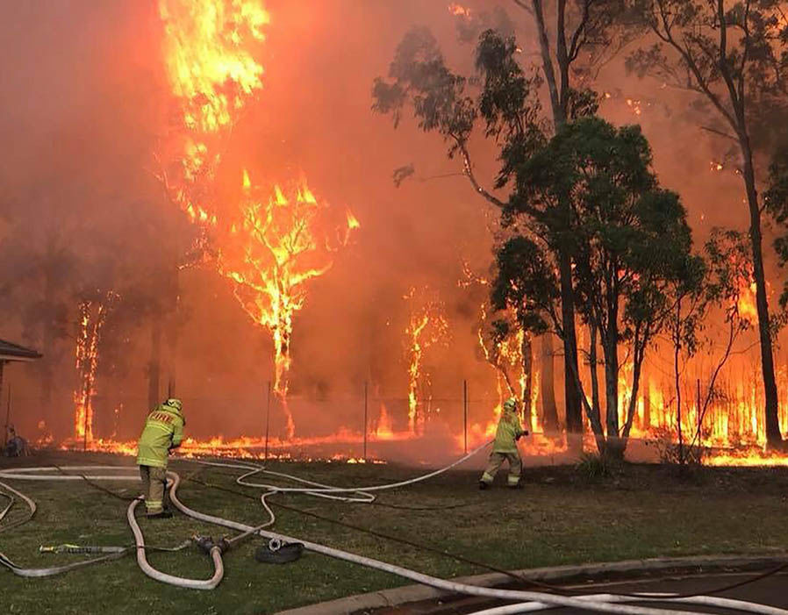
The escalating fire risk

Slide 8
The politics of Climate Change
7 Prime Ministers in 10 years .
Australia fails to achieve agreement on National Energy Guarantee.
Increased political power of right wing influence sympathetic to non renewable energy – power of the coal lobby.
Australia now the ”laughing stock” of Westminster Parliamentary democracy.
The international humiliation of potentially setting carbon emission targets significantly lower than China.
Despite the stone walling of politicians, Australians have one of the highest up takes of renewable energy for domestic use , in the World ( currently 1in 4 homes) 48% of power generation in South Australia is through renewables.
3.5 million solar panels installed in homes in 2017.

Slide 9
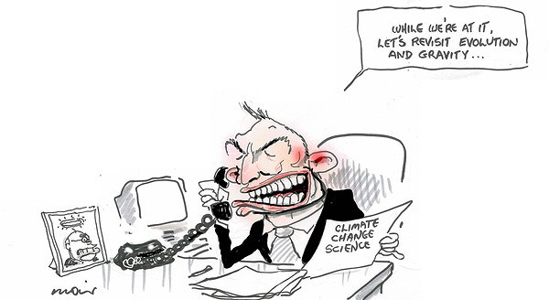

Slide 10
Political landscape.
Australians are ignoring the lead of their Federal politicians and increasingly reverting to solar and other renewable energy sources.
The political turmoil of recent events is likely to result in a Federal election either later this year or early 2019 and a significant swing to the Green Party and political independents , and away from the current right wing conservative government.
There is an increasingly public awareness in Australia of our particular vulnerability to the ravages of climate change balanced against a desire to reduce energy costs and maintain insurance premiums at affordable levels .
There is a similar concern and understanding of the need to conserve water.

Slide 11
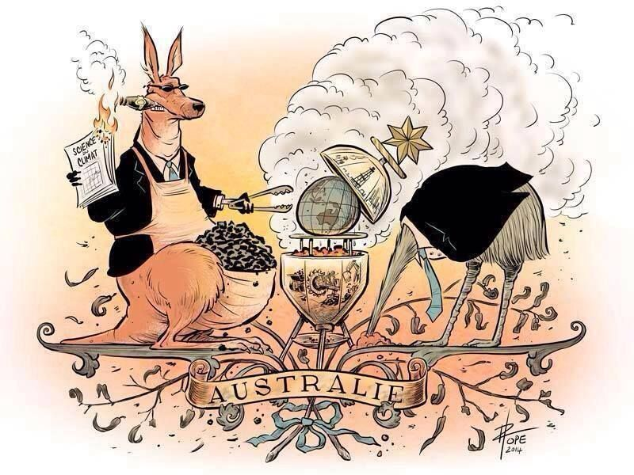

Slide 12
Coal …. The mineral Australians don’t want !
9 inefficient brown and black coal power generation plants have already been closed –
Liddell ( NSW) , Munmorah ( NSW) , Redbank ( NSW) Wallerawang (NSW) , Morwell ( Victoria) , Anglesea ( Victoria) , Collinsville (Queensland), Swanbank B ( Queensland), Northern (SA), Playford( SA).
Liddell in NSW is planned for closure 2022 .
The Adani ( Indian company) proposed Carmichael Coal Mine in Norther Queensland is attracting strong opposition nationally.
Queensland land Labor Government has vetoed moves to grant $ 1 billion loan through the Commonwealth’s Northern Australia Infrastructure Facility.
Legal challenge to its indigenous land use agreement with traditional owners.

Slide 13
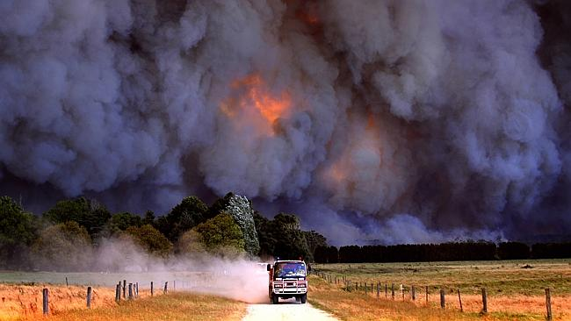
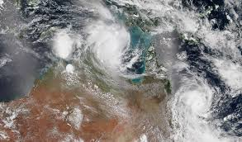
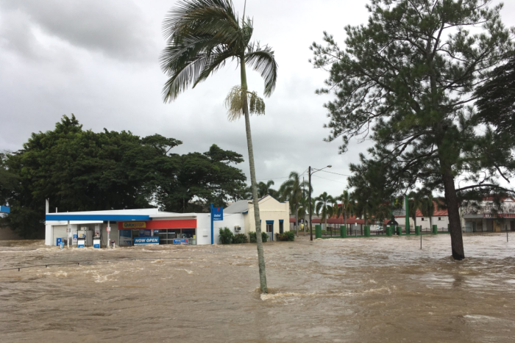
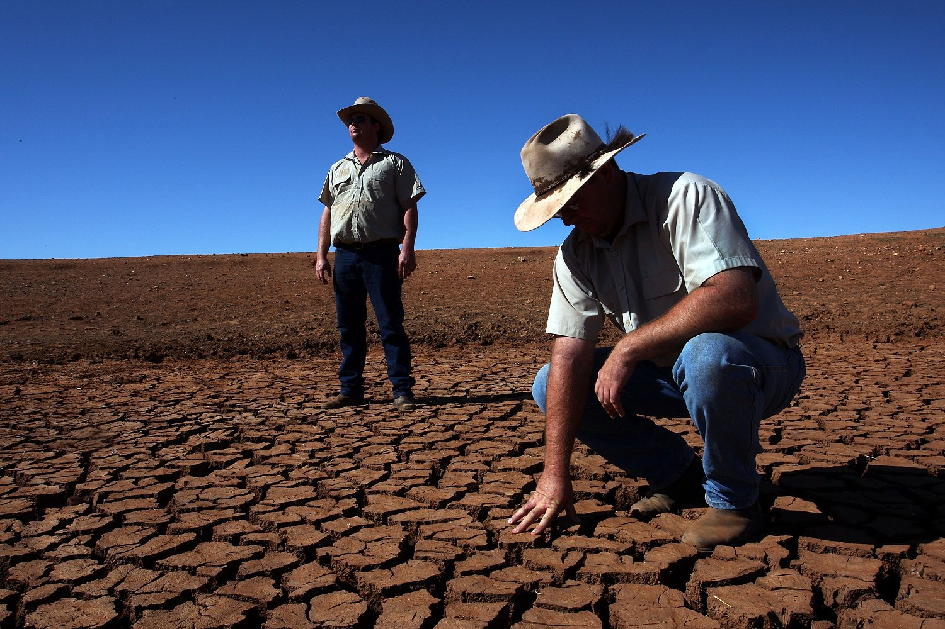
…unfortunately the “lucky country” isn’t quite as lucky as it used to be !

